Slide 1
Working with JSON
Lesson 03

Slide 2
Lesson Objectives
JSON Introduction
JSON Types
Working with JSON Object
Using JSON in jQuery
Notes:
Explain the lesson coverage

Slide 3
3.1. JSON Introduction
JSON Introduction
Java Script Object Notation
JSON is a lightweight format for exchanging data between the client and server.
JSON is a syntax for passing around objects that contain name/value pairs, arrays and other objects.
It is often used in AJAX applications because of its simplicity and its format is based on JavaScript object literals.
JSON is language independent and text based. It is easy to parse and generate.
Supported by most of the languages.
Notes:
Additional notes for instructor
AJAX application:
AJAX stands for Asynchronous JavaScript and XML. AJAX is a new technique for creating better, faster, and more interactive web applications with the help of XML, HTML, CSS, and Java Script.
Ajax uses XHTML for content, CSS for presentation, along with Document Object Model and JavaScript for dynamic content display.
Conventional web applications transmit information to and from the server using synchronous requests. It means you fill out a form, hit submit, and get directed to a new page with new information from the server.
With AJAX, when you hit submit, JavaScript will make a request to the server, interpret the results, and update the current screen. In the purest sense, the user would never know that anything was even transmitted to the server.
XML is commonly used as the format for receiving server data, although any format, including plain text, can be used.
AJAX is a web browser technology independent of web server software.
A user can continue to use the application while the client program requests information from the server in the background.
Intuitive and natural user interaction. Clicking is not required, mouse movement is a sufficient event trigger.

Slide 4
3.2. JSON Types
JSON Types
Number : integer, real or floating point
String : double-quoted Unicode with backslashes
Boolean : true and false
Array : ordered sequence of comma-separated values enclosed in square brackets
Object : collection of comma-separated “key”:value pairs enclosed in curly braces
null
Notes:
Additional notes for instructor

Slide 5
3.3. Working with JSON Object
JSON Object Notation
A JSON object is an unordered set of name/value pairs
  A JSON object begins with { (left brace) and ends with } (right brace)
  Each name is followed by : (colon) and the name/value pairs are separated by , (comma) and enclosed with in quotes.
var jsonObject = {"Name":"Karthik", "Company":“Capgemini"}
It is very easy to parse JSON. In JavaScript, the parsing process is immediate: All we have to do is pass the JSON string to the JavaScript eval() function
  var parsedJson = eval(jsonObject);
Notes:
Additional notes for instructor

Slide 6
3.4. Using JSON in jQuery
Using JSON in jQuery
A JSON object can be passed as input into jQuery Methods, so that we can avoid method chaining.
We can parse a JSON string in jQuery using the following syntax
var obj = jQuery.parseJSON(jsonString);
Notes:
Additional notes for instructor

Slide 7
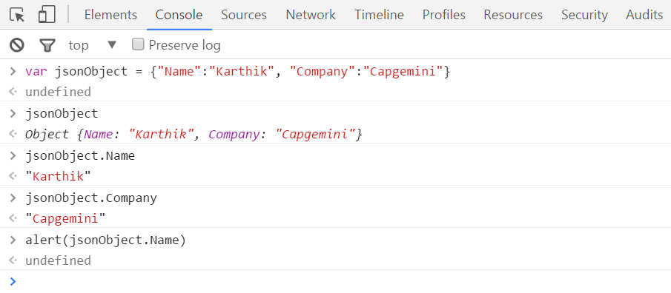
3.4. Using JSON in jQuery
Using JSON in jQuery
Notes:
Additional notes for instructor

Slide 8
3.4. Using JSON in jQuery
Demo
$(document).ready(function()
{
var jsonString = '{"company":"Capgemini"}';
//Parsing a JSON string.
var obj = jQuery.parseJSON(jsonString);
alert('Company : '+obj.company );
});
Notes:
Add the notes here.
Additional notes for instructor

Slide 9
Summary
JSON is a lightweight format for exchanging data between the client and server.
JSON objects are typed
JSON is language independent and text based. It is easy to parse and generate
It is often used in AJAX applications because of its simplicity
Notes:
Add the notes here.
Additional notes for instructor

Slide 10
Lab
3.1.Working with JSON Object
3.2.Working with JSON Object and Array
3.3.Using JSON object in jQuery
Notes:
Add the notes here.
Additional notes for instructor

Slide 11
Review Question
Question 1 : JSON is language dependent?
      A. True
      B. False
Question 2 : _______________ is not a valid JSON type
      A. Boolean
      B. String
      C. Date
      D. Array
Notes:
Add the notes here.
Answers for the Review Question 1: B
Question 2: C

